Slide 1
6 Plant Biotechnology
Brief Chapter Outline
I. Plant Tissue Culture and Applications
A. Plant Tissue Culture
B. Micropropagation: Somatic Embryos - Chemicals from Plants
C. Other Uses of Tissue Culture: Protoplast Fusion - Somaclonal Variation - Germplasm Storage
II. Plant Genetic Engineering
A. Plant Transformation and Agrobacterium tumefaciens
B. Challenges of Foreign Gene Expression
Applications of Plant Genetic Engineering
A. Crop Improvement
B. Genetically Engineered Traits: The Big Six
1. Herbicide Resistance: Glyphosate - Glufosinate - Bromoxynil - Sulfonylurea
2. Insect Resistance
3. Virus Resistance: Yellow Squash and Zucchini - Potato - Papaya
4. Altered Oil Content
5. Delayed Fruit Ripening - What Happened to the Flavr Savr Tomato?
6. Pollen Control
C. Biotech Revolution: Cold and Drought Tolerance and WeatherGard Genes
D. Genetically Engineered Foods: Soybeans – Corn – Canola – Cotton - Other Crops
E. Nutritionally Enhanced Plants—Golden Rice: An International Effort
1. Cause for Concern? The Case of StarLink Corn
Genetically Engineered Foods and Public Concerns
F. Molecular Farming: Edible Vaccines - Biopolymers and Plants
IV. A Bright Future

Slide 2
I. Plant Tissue Culture and Applications
A. Plant Tissue Culture.
1. Defined as the sterile, in vitro cultivation of plant parts such as organs, embryos, seeds, and single cells on solidified or liquid media.
2. Differentiated (committed) cells can to be cultured to generate whole plants, with the use of very little starting material.
3. Meristematic tissue (growing dividing cells) is used to grow flowering plants, and is virus-free, which is important for plant propagation.
4. The basic steps of plant tissue culture are:
a) Remove a piece of tissue from a plant, called an explant.
b) Place the explant on a specific nutrient medium to force the cells of the explant to become undifferentiated and form callus tissue (Figure 6.1). This is called dedifferentiation.
c) Callus tissue is transferred to another nutrient medium where it is allowed to differentiate into plant tissue. This is called redifferentiation.
d) The plant is transferred to soil to complete plant growth.
5. The ability of a plant cell to give rise to a whole plant through dedifferentiation and redifferentiation is called “totipotency.”

Slide 3
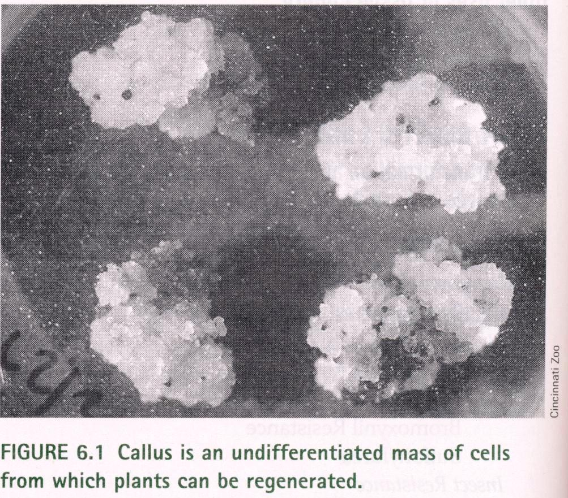

Slide 4
There are six types of in vitro culture types that can create a whole plant:
a) Callus culture—culture of differentiated tissue from an explant that dedifferentiates (Figure 6.2).
b) Cell supspension culture—culture of cells or cell aggregates (small clumps of cells) in liquid medium.
c) Protoplast culture—culture of plant cells with their cell walls removed.
d) Embryo culture—culture of isolated embryos.
e) Seed culture—culture of seeds to generate plants.
f) Organ culture—culture of isolated plant organs like anthers, roots, buds, and shoots.

Slide 5
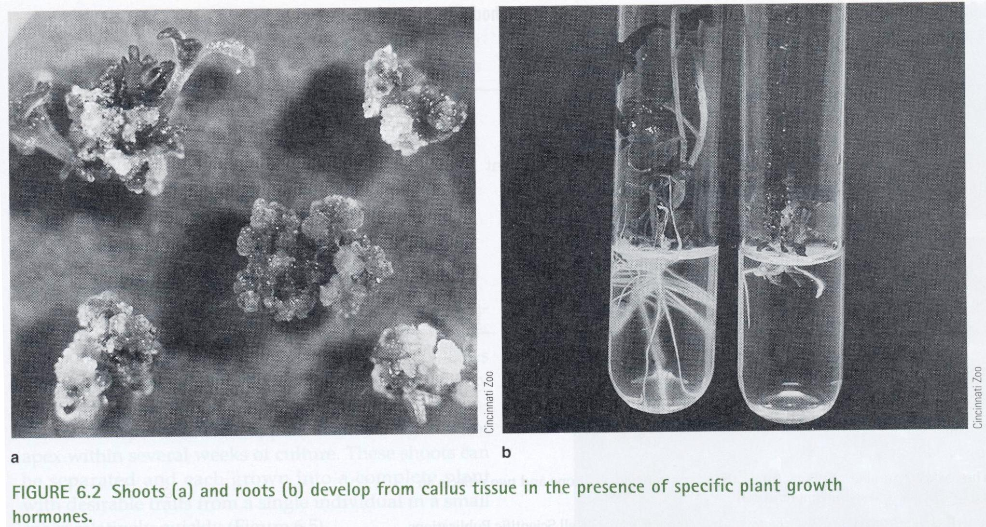

Slide 6
Micropropagation
1. Desirable plants are cloned through tissue culture in a process called “in vitro clonal propagation” (also called “micropropagation”).
2. Forms the basis of a multimillion-dollar industry because of the potential to create many more plants from the same starting material (Table 6.1).
3. There are four stages of micropropagation (Figure 6.3):
a) Stage 1—initiation of sterile explant culture, which is the selection of explants, sterilization of tissue surface to prevent contamination, and transfer of explants to nutrient media.
b) Stage 2—shoot initiation, which is the multiplication of shoot tissue from explants on
a second type of nutrient media.
c) Stage 3—root initiation, which is the multiplication of root tissue from explants on nutrient media.
d) Stage 4—transfer of plants to sterile soil or other substrate under controlled conditions
to grow complete plants.
4. Amounts of nutrients such as vitamins, sucrose, and plant growth hormones can control
culture growth. For example, altering the amounts of the hormones auxin and cytokinin induces multiple shoots to form from a culture (Figure 6.5).

Slide 7
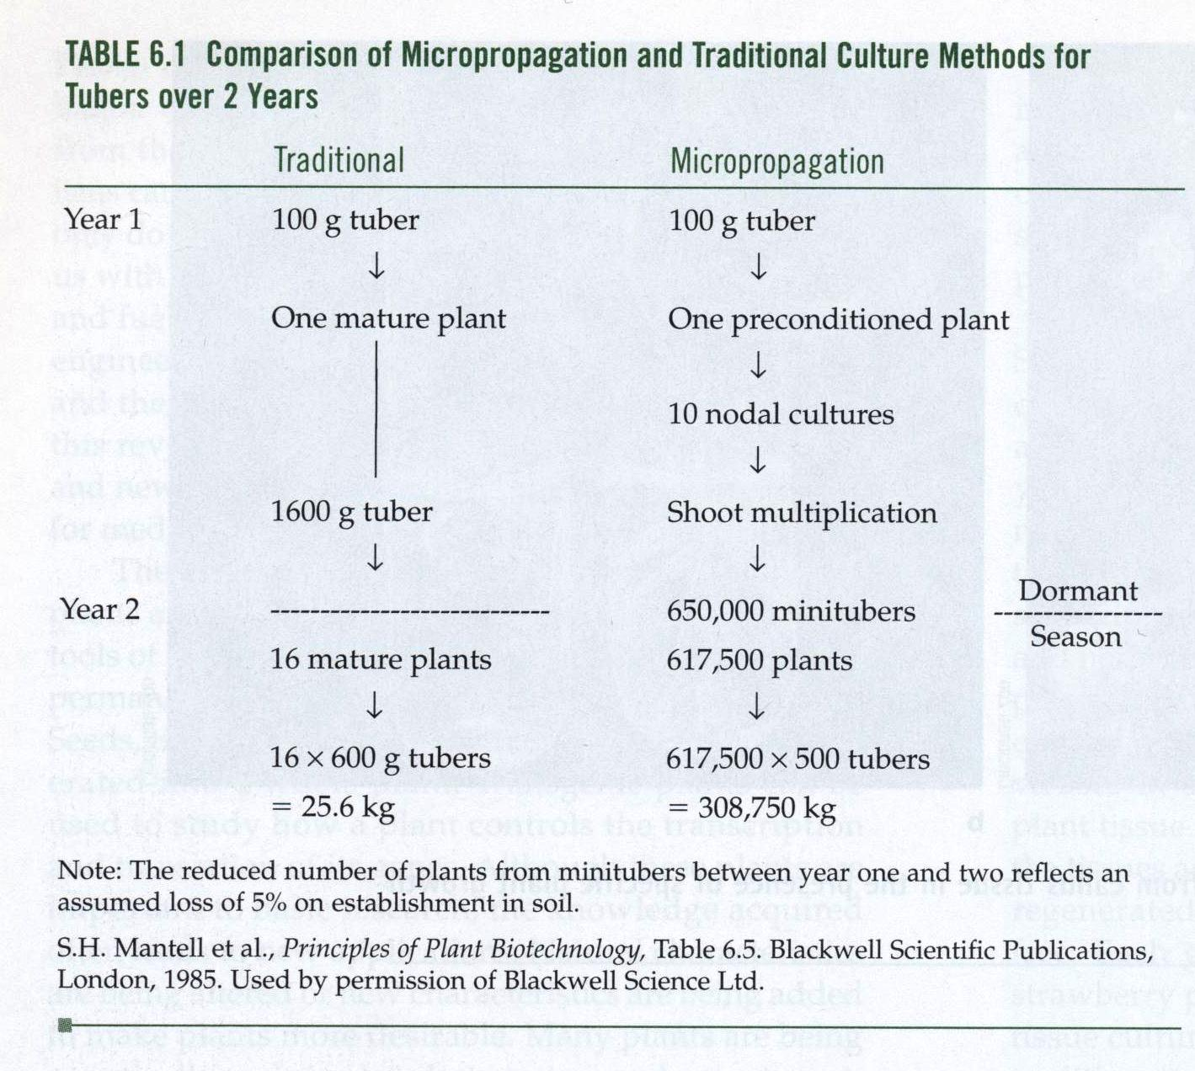

Slide 8
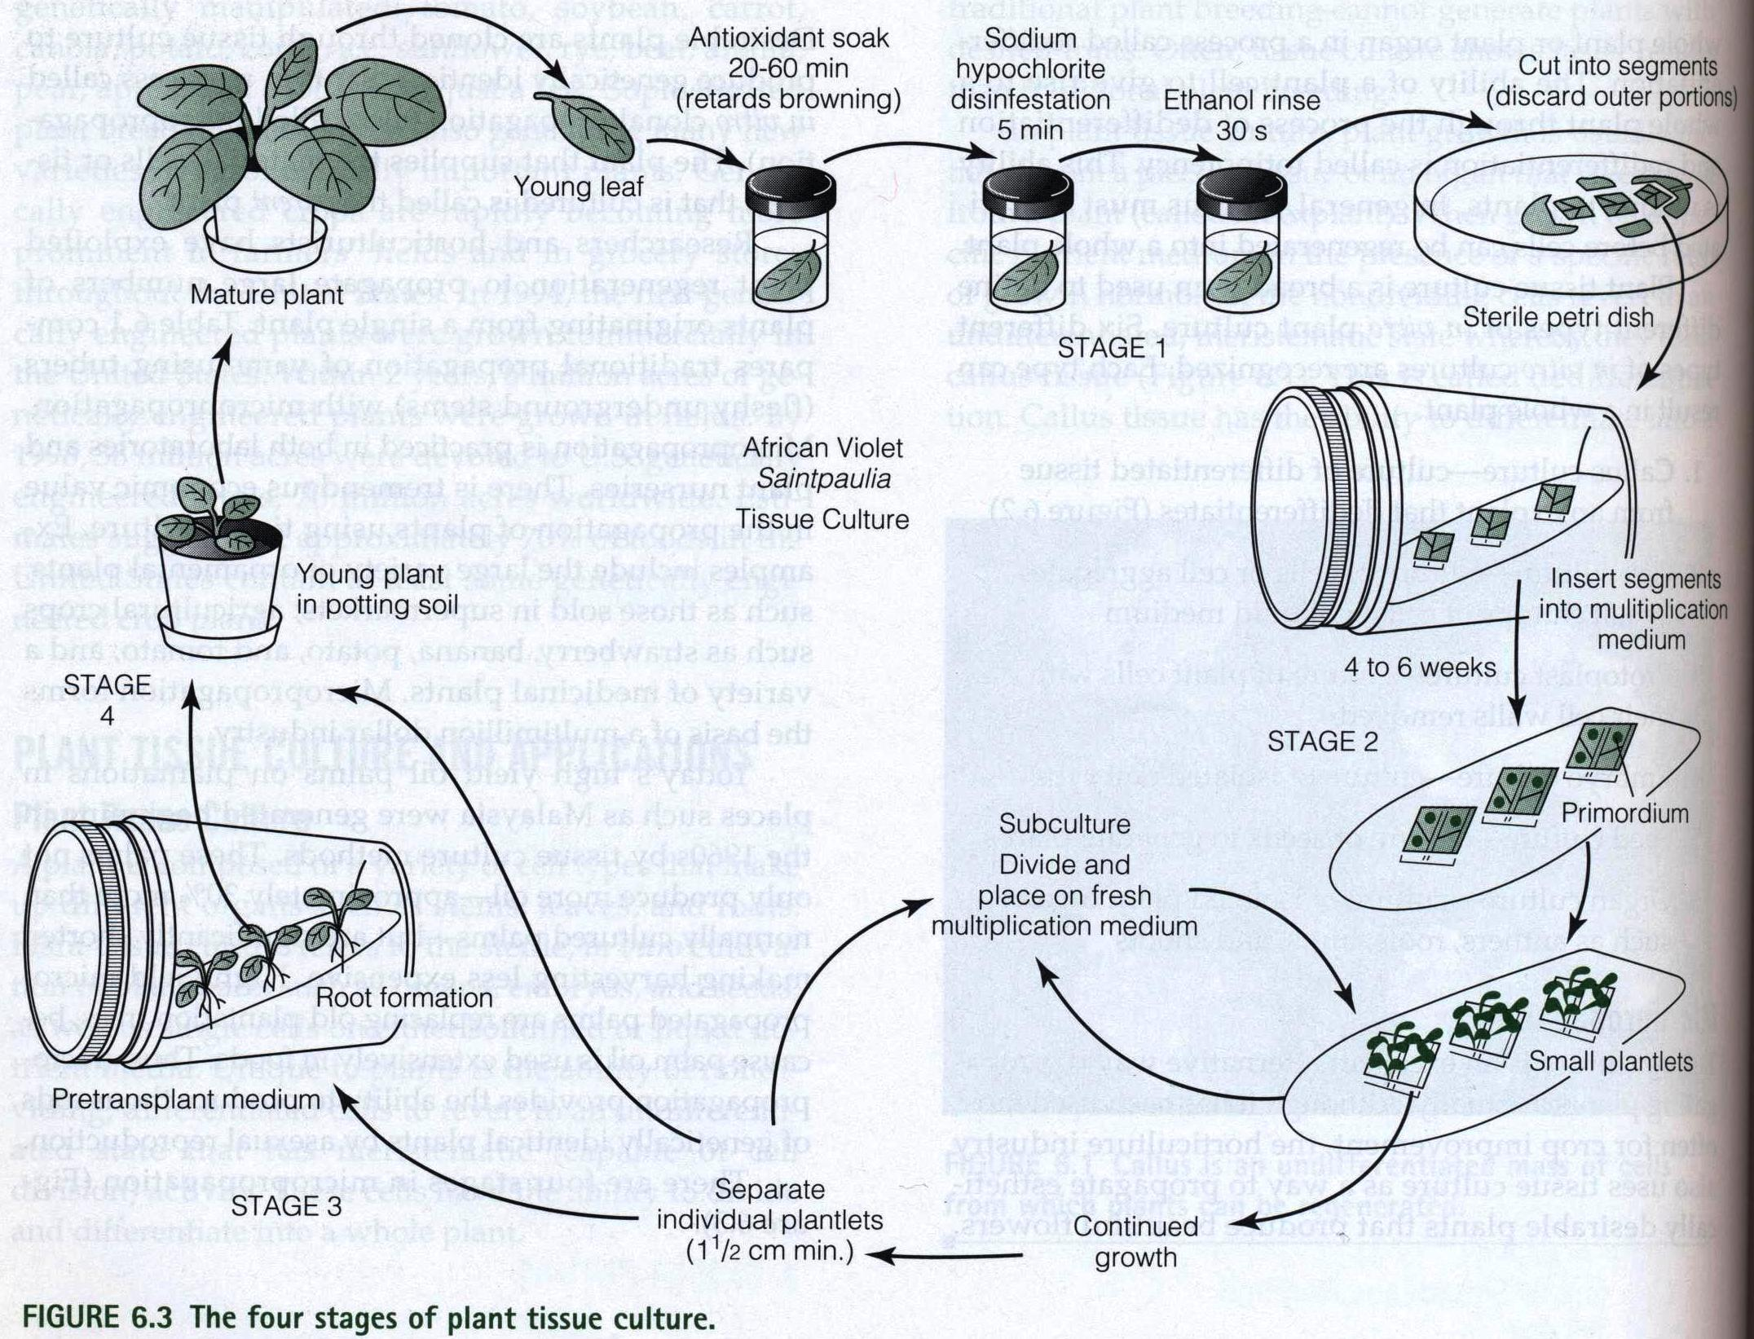

Slide 9
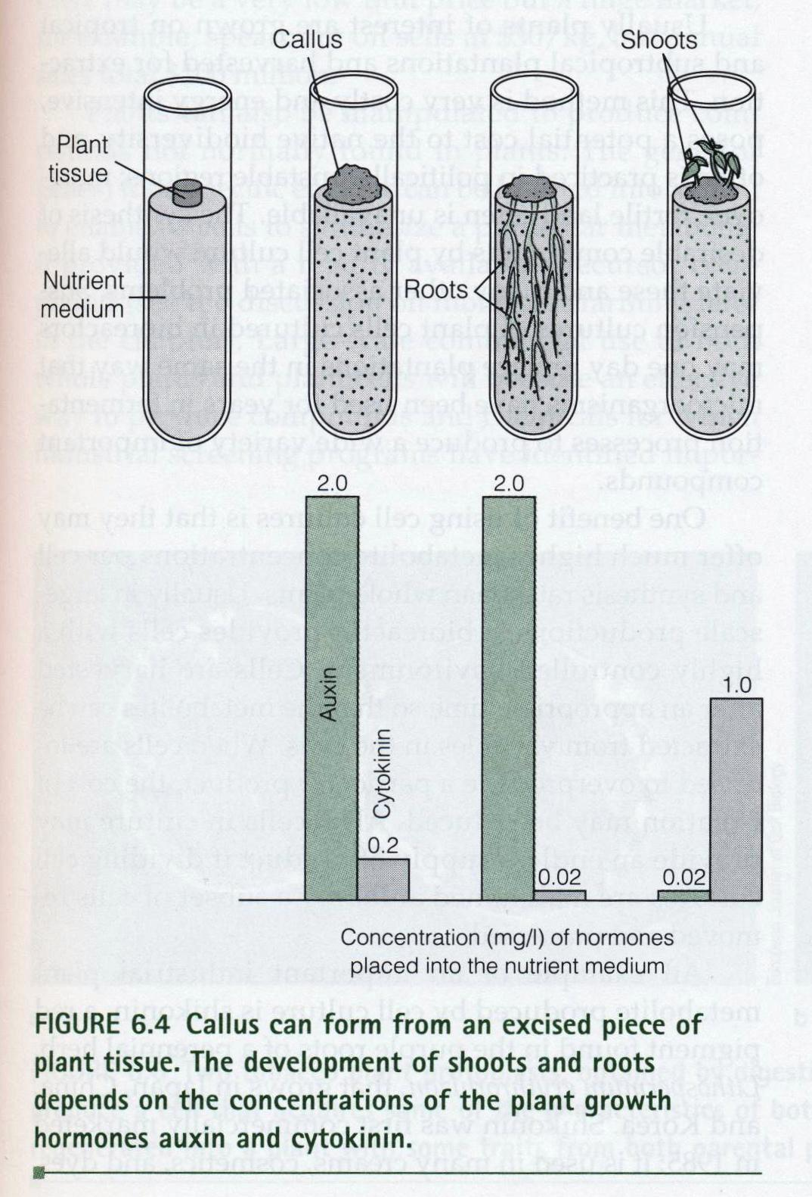

Slide 10
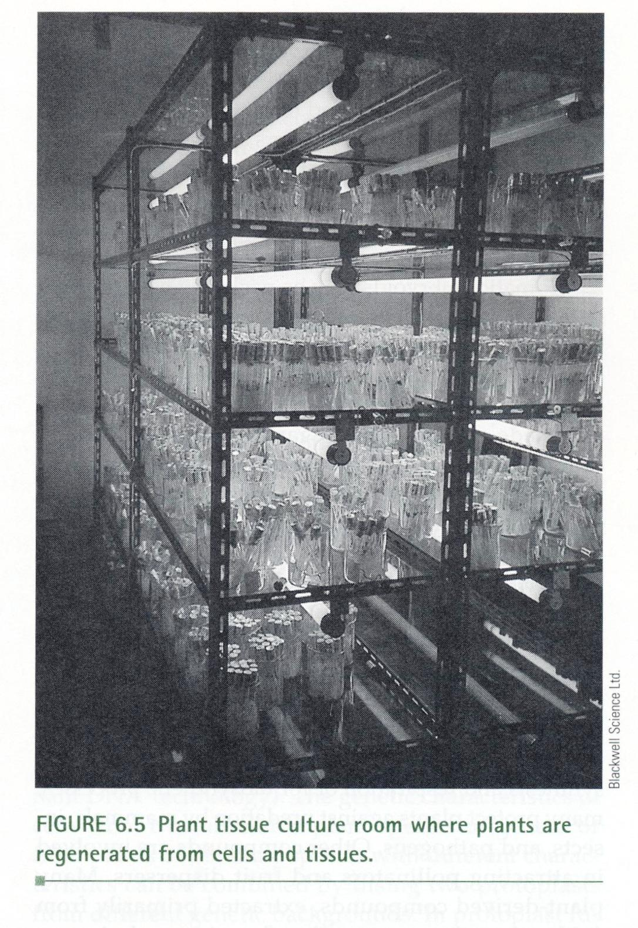

Slide 11
Somatic Embryos (Somatic Embryogenesis)
a) Produces embryo-like structures called “embryoids” from plant tissues.
b) Hormones such as auxins disrupt normal tissue development and form embryoids from regular tissues.
c) Callus can also be used, by changing hormones to induce embryoid formation, and each embryoid can form into a new plant.
d) Can also be produced in liquid culture, by using single cells or plant tissue:
(1) The cell walls are digested with enzymes to form protoplasts.
(2) Cell walls regenerate, cell division begins, and clumps form.
(3) The clumps are plated on a solid medium to form shoots and roots.
e) This is the preferred method for large-scale commercial production, using bioreactors to produce millions of embryoids.
f) Embryoids may also be packaged as artificial seeds, which are encapsulated for distribution and protected with a complex of agar and other gel-forming compounds, and stored in a protective, hydrated gel with nutrients.

Slide 12
Chemicals From Plants
a) Primary metabolites and secondary metabolites are useful to plants for functions such as protection from mammals, insects, and pathogens. Many of these chemicals are useful in medicine and food (Table 6.2).
b) More than 25% of pharmaceuticals in the United States come from plants, and 75% of the world’s population relies on herbal medicines.
c) In many cases, the development of a drug begins with the identification of an herbal medicine that is widely used, usually by indigenous people. The chemical is isolated, chemically synthesized, and then tested in clinical trials.

Slide 13
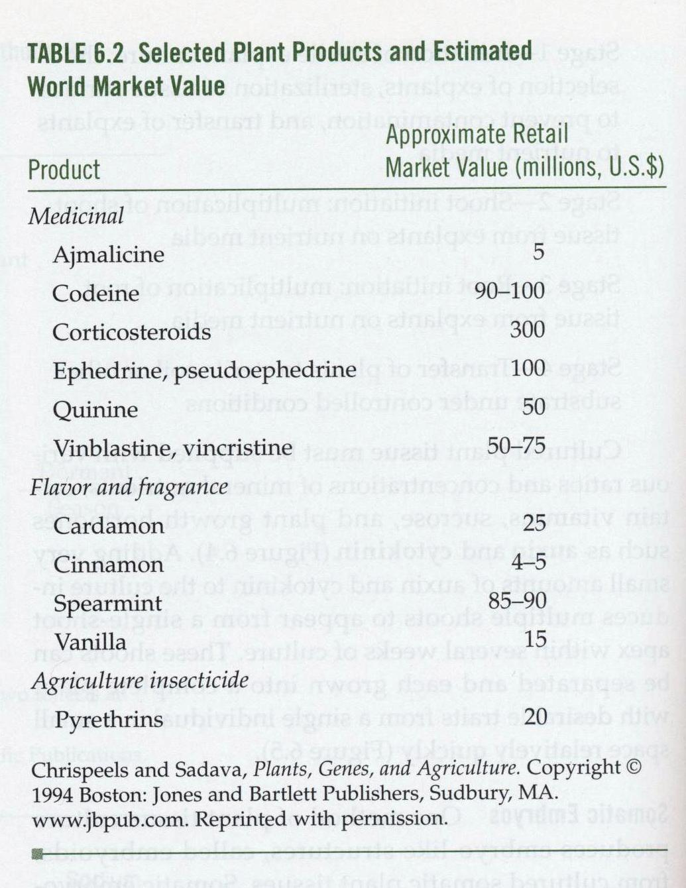

Slide 14
Plant cell culture:
(1) May provide chemicals without having to use tropical and subtropical
plantations to grow whole plants, which can be costly and damaging to the environment.
(2) May produce higher amount of metabolites than whole plants, if the environment is tightly controlled, such as in a bioreactor.
(3) Shikonin, a chemical that is used in many creams, cosmetics, and dyes, has been produced in large bioreactors to a yield of about 1.5 to 4.0 grams of shikonin per liter of culture.
(4) Many production procedures take too much time (up to ten years) and cost too much to develop, so sales must recover the costs.
(5) Genes can be inserted into plants to enable plant cells to produce metabolites that they do not normally make.
(6) May be harmful to developing countries, which rely on people having to extract metabolites from plants rather than producing them.

Slide 15
C. Other Uses of Tissue Culture
1. Protoplast Fusion (Figure 6.6).
a) Protoplasts are generated by digesting the cell wall.
b) Two protoplasts from two unrelated plant species are fused with chemicals or electroporation.
c) The genetic material is mixed together, and the hybrid cell is screened for desirable traits.
2. Somaclonal Variation.
a) The genetic variability produced by plant tissue culture. The variability can be exploited to improve characteristics of crop and ornamental plants, such as in corn, wheat, barley, and potato.
b) Traits such as salt and metal tolerance, insect resistance, and improved seed quality can be generated through selection processes.
c) Genetic variability is caused by changes in the chromosome number due to chromosome rearrangements, gene amplification, and the activation of transposable elements (“jumping genes”). As a result, daughter

Slide 16
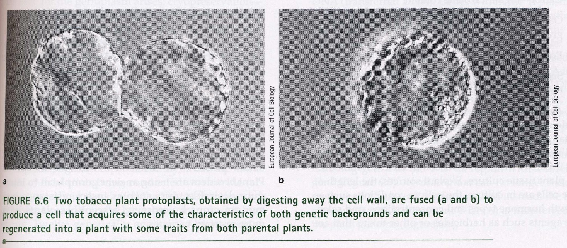

Slide 17
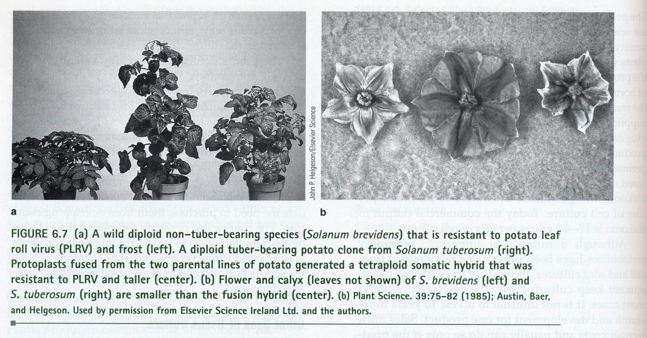

Slide 18
3. Germplasm Storage.
a) The genetic material of a plant may contain important characteristics and increase hardiness in plants, such as resistance to drought and pests.
b) Ancient germplasm is used to introduce new traits, such as insect resistance, into
modern plants.
c) Germplasm is being lost due to the loss of traditional farming practices, clearing of old fields, and the use of modern plants in place of older plants.
d) Gene banks.

Slide 19
Genetically Engineered Plants
A. Plant Transformation and Agrobacterium tumefaciens.
1. A common soil bacterium that causes crown gall disease.
2. The bacterium enters sites where a plant has been injured.
3. The bacterium has a plasmid called the “Ti plasmid” that contains genes called “vir (virulence) genes” that encode a protein that transfers a region of the plasmid called “T-DNA” to cells at the wound.
4. Once plant cells are infected, plant hormones stimulate growth of tumor cells.
5. The T-DNA has been engineered to have its vir genes removed, so that foreign DNA can be inserted into plant genomes, transforming the plant (Figure 6.9).
6. A general method for transformation:
a) Cells such as leaf disks, seedling or plant buds, and protoplasts receive the DNA, and the cells grow.
b) Media is used to select for cells with the new trait.
c) Desired cells are cultured on solid media to form callus tissue.
d) Hormones are modified to promote shoot and root formation.
e) Plants are examined to see if the foreign gene is being expressed.

Slide 20
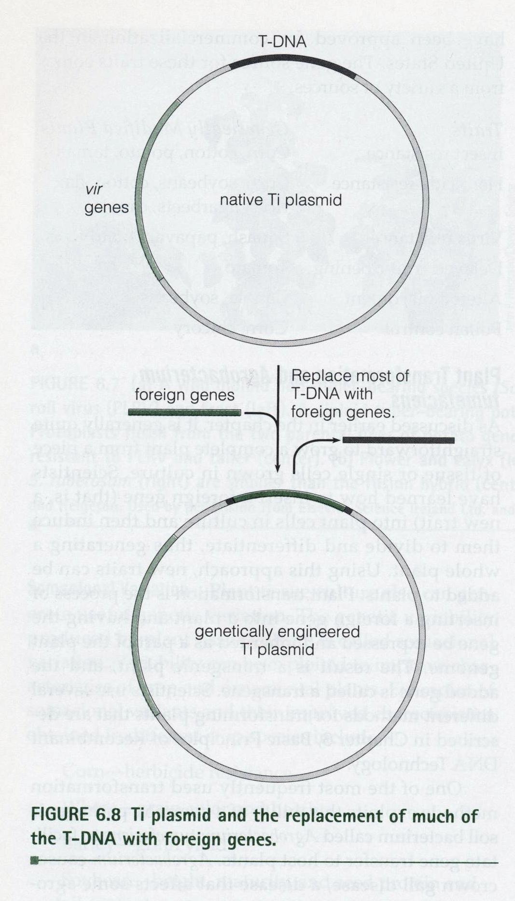

Slide 21
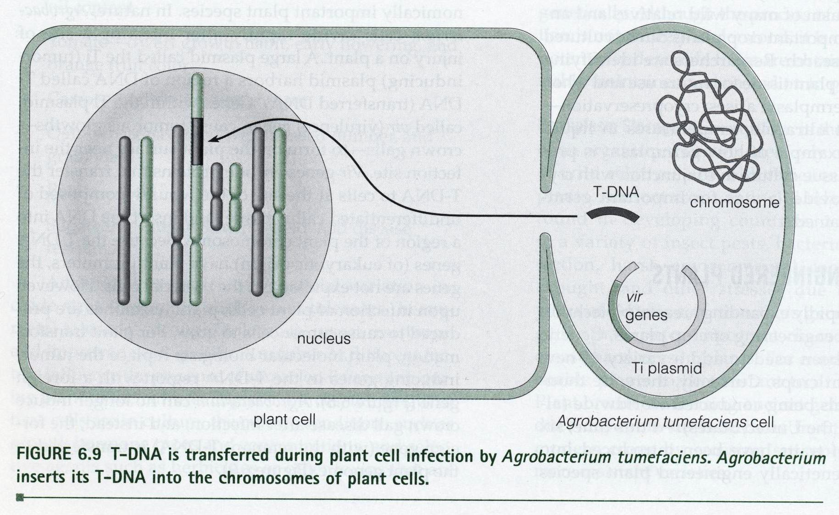

Slide 22
Challenges of Foreign Gene Expression
1. In plants there are promoter and enhancer elements involved in transcription.
2. There are two major factors that determine if genes are expressed at the right time and in the right amount:
a) A gene must be delivered to all cells and be stable for transfer to offspring:
- The promoter must be recognized and either regulated or always active. A strong promoter that is commonly used in the cauliflower mosaic virus 35S (CaMV 35S) promoter, and the promoter for the ribulose 1,5 bisphosphate carboxylase is regulated by light.
- Termination and polyadenylation signals must also be provided. (3) Organelle or tissue-specific targeting sequences may be needed.
b) Codon usage:
- Genes need to specify amino acids that match the host plant’s tRNA and amino
acid pools.
- Genes can be remade to reflect proper codons (codon engineering).

Slide 23
Applications of Plant Genetic Engineering.
A. Crop Improvement.
1. The following traits are potentially useful to plant genetic engineering: controlling insects, manipulating petal color, production of industrially important compounds, and plant growth in harsh conditions.

Slide 24
B. Genetically Engineered Traits: The Big Six.
1. Herbicide Resistance.
a) Herbicides are a huge industry, with herbicide use quadrupling between 1966 and 1991, so plants that resist chemicals that kill them are a growing need.
b) Critics claim that genetically engineered plants will lead to more chemical use and possible development of weeds resistant to the chemicals.
c) Glyphosate Resistance.
(1) Marketed under the name Roundup, glyphosate inhibits the enzyme EPSPS, makes aromatic amino acids.
(2) The gene encoding EPSPS has been transferred from glyphosate- resistant E. coli into plants, allowing plants to be resistant.

Slide 25
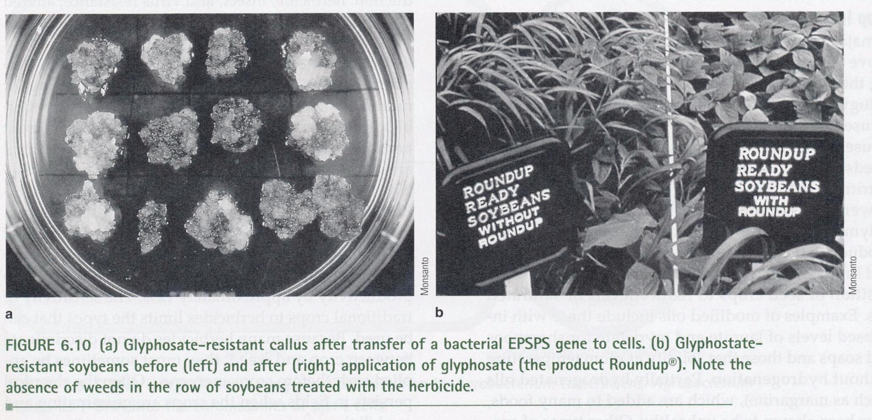

Slide 26
d) Glufosinate Resistance.
(1) Glufosinate (the active ingredient being phosphinothricin) mimics the structure of the amino acid glutamine, which blocks the enzyme glutamate synthase.
(2) Plants receive a gene from the bacterium Streptomyces that produce a protein that inactivates the herbicide.
e) Bromoxynil Resistance.
(1) A gene encoding the enzyme bromoxynil nitrilase (BXN) is transferred from Klebsiella pneumoniae bacteria to plants.
(2) Nitrilase inactivates the Bromoxynil before it kills the plant.
f) Sulfonylurea.
(1) Kills plants by blocking an enzyme needed for synthesis of the amino acids valine, leucine, and isoleucine.
(2) Resistance generated by mutating a gene in tobacco plants, and transferring the mutated gene into crop plants.

Slide 27
2. Insect Resistance.
a) The Bt toxin isolated from Bacillus thuringiensis has been used in plants. The gene has been placed in corn, cotton, and potato, and has been marketed.
b) Plant protease inhibitors have been explored since the 1990s:
(1) Naturally produced by plants, are produced in response to wounding.
(2) They inhibit insect digestive enzymes after insects ingest them, causing
starvation.
(3) Tobacco, potato, and peas have been engineered to resist insects such as weevils that damage crops while they are in storage (Figure 6.12).
(4) Results have not been as promising as with Bt toxin, because it is believed that insects evolved resistance to protease inhibitors.

Slide 28
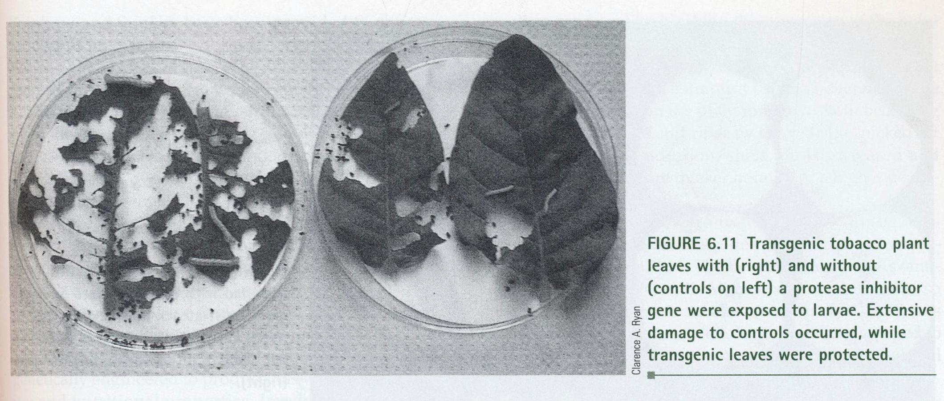

Slide 29
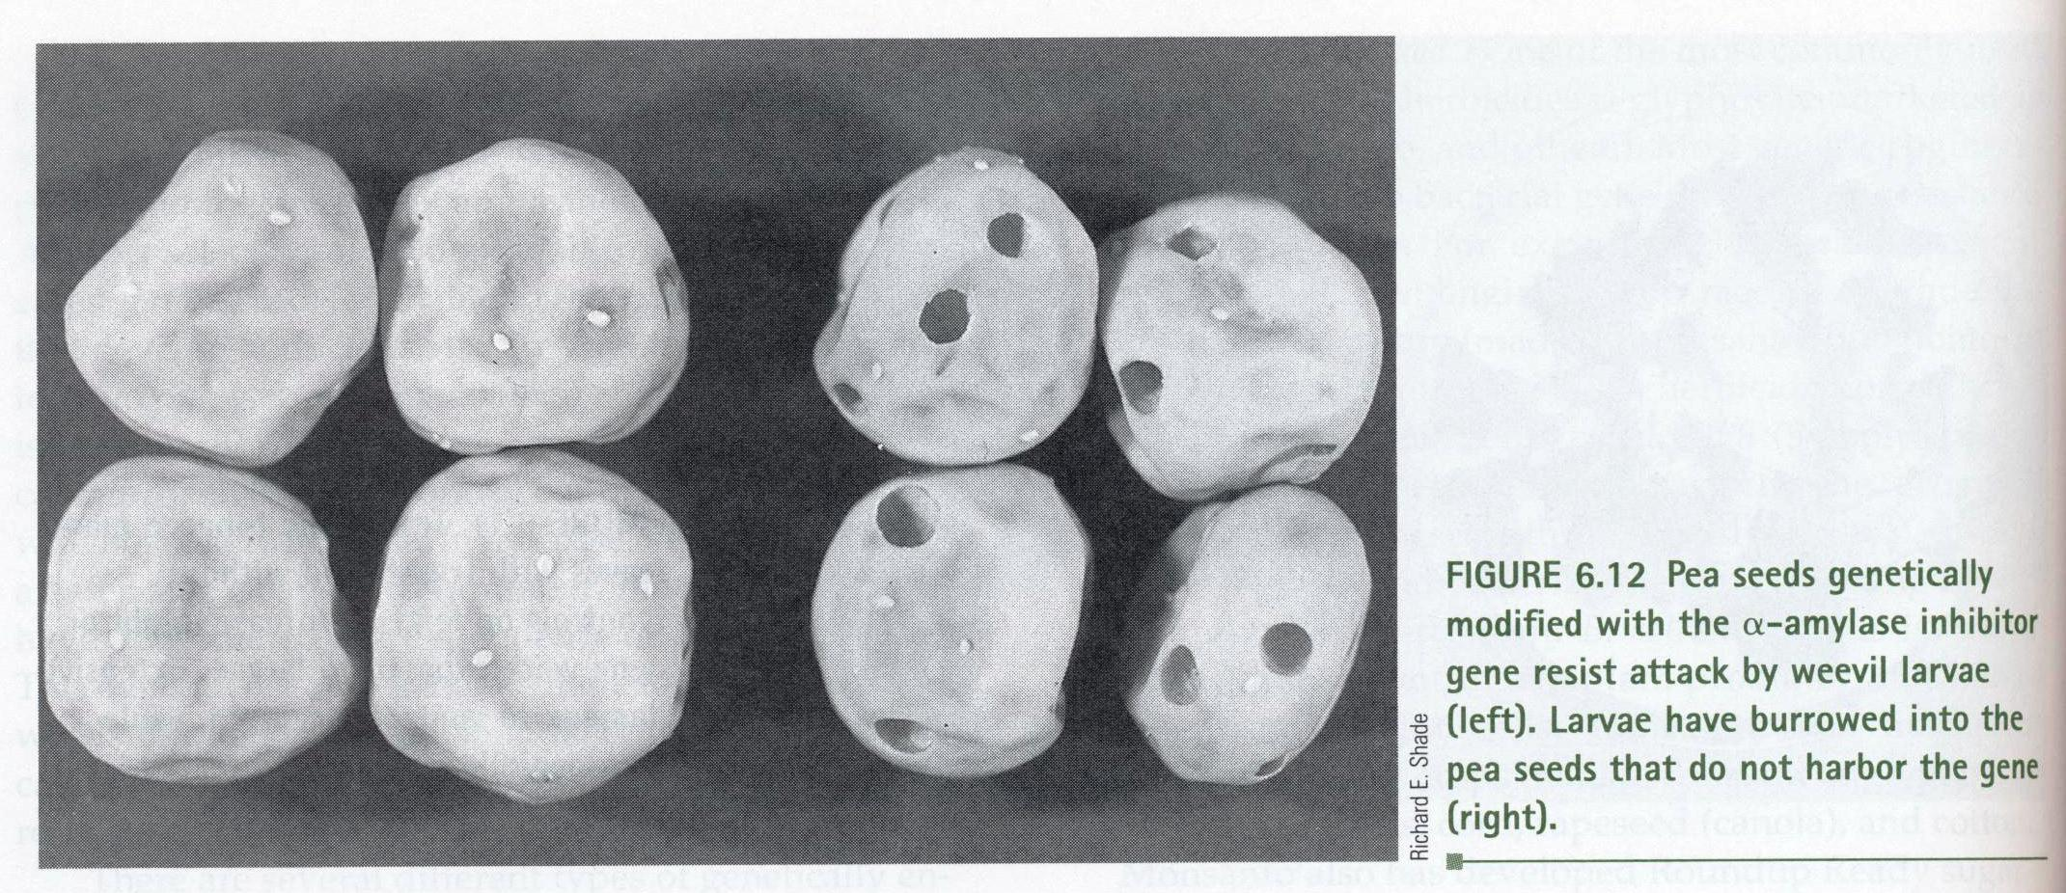

Slide 30
Virus Resistance.
a) Chemicals are used to control the insect vectors of viruses, but controlling the disease itself is difficult because the disease spreads quickly.
b) Plants may be engineered with genes for resistance to viruses, bacteria, and fungi.
c) Virus-resistant plants have a viral protein coat gene that is overproduced, preventing the virus from reproducing in the host cell, because the plant shuts off the virus’ protein coat gene in response to the overproduction.
d) Coat protein genes are involved in resistance to diseases such as cucumber mosaic virus, tobacco rattle virus, and potato virus X.
e) Resistance genes for diseases such as fungal rust disease and tobacco mosaic virus have been isolated from plants and may be transferred to crop plants.
f) Yellow Squash and Zucchini.
- Seeds are available that are resistant to watermelon mottle virus, zucchini yellow mosaic virus, and cucumber mosaic virus.
g) Potato.
(1) Monsanto developed potatoes resistant to potato leaf roll virus and potato virus X, which also contained a Bt toxin gene as a pesticide.
(2) Chain restaurants do not use genetically engineered potatoes due to public pressures.
h) Papaya.
- Varieties resistant to papaya ring spot virus have been developed.

Slide 31
4. Altered Oil Content.
a) Done in plants by modifying an enzyme in the fatty acid synthesis pathway (oils are lipids, which fatty acids are a part of).
b) Varieties of canola and soybean plants have been genetically engineered to produce oils with better cooking and nutritional properties.
c) Genetically engineered plants may also be able to produce oils that are used in detergents, soaps, cosmetics, lubricants, and paints.

Slide 32
5. Delayed Fruit Ripening.
a) Allow for crops, such as tomatoes, to have a higher shelf life.
b) Tomatoes generally ripen and become soft during shipment to a store.
c) Tomatoes are usually picked and sprayed with the plant hormone ethylene to induce ripening, although this does not improve taste.
d) Tomatoes have been engineered to produce less ethylene so they can develop more taste before ripening, and shipment to markets.
e) What happened to the Flavr Savr tomato?
(1) Produced by Calgene by blocking the polygalacturonase (PG) gene, which is involved in spoilage. PG is an enzyme that breaks down pectin, which is found in plant cell walls.
(2) Plants were transformed with the anti-sense PG gene, which is mRNA that base pair with mRNA that the plant produces, essentially blocking the gene from translation.
(3) First genetically modified organism to be approved by the FDA, in 1994.
(4) Tomatoes were delicate, did not grow well in Florida, and cost much more than regular tomatoes.
(5) Calgene was sold to Monsanto after Monsanto filed a patent- infringement lawsuit against Calgene, and the Flavr Savr tomato left the market.

Slide 33
6. Pollen Control.
a) Hybrid crops are created by crossing two distantly related varieties of the same crop plant.
b) The method may generate plants with favorable traits, such as tall soybean plants that make more seeds and are resistant to environmental pressures.
c) For success, plant pollination must be controlled. This is usually done by removing
the male flower parts by hand before pollen is released. Also, sterilized plants have been genetically engineered with a gene from the bacteria Bacillus amyloliquefaciens.

Slide 34
C. Biotech Revolution: Cold and Drought Tolerance and WeatherGard Genes.
1. Plants such as fruits are subject to frost damage at low temperatures, as well as from loss of water. They can be genetically engineered to resist these conditions and increase crop yields as a result.
2. To resist cold weather, cold-regulated (COR) genes are also called “antifreeze genes,”
which encode proteins that protect plant cells from frost damage.
3. A transcription factor for a group of COR genes called “CBF” was patented as WeatherGard in 1997 by a group at Michigan State University. The genes also provide drought tolerance and tolerance to high-salt soils.
4. All major crop species, including corn, soybean, and rice contain CBF genes.
5. Genetically engineering plants with CBF genes survive temperatures as much as 4 to 5°C
lower than non-engineered plants.

Slide 35
D. Genetically Engineered Foods.
1. More than 60% of processed foods in the United States contain ingredients from genetically engineered organisms.
2. Twelve different genetically engineered plants have been approved in the United States, with many variations of each plant, some approved and some not.
3. Soybeans.
a) Soybean has been modified to be resistant to broad-spectrum herbicides.
b) Scientists in 2003 removed an antigen from soybean called P34 that can cause a severe allergic response.
4. Corn.
a) Bt insect resistance is the most common use of engineered corn, but herbicide resistance is also a desired trait.
b) Products include corn oil, corn syrup, corn flour, baking powder, and alcohol.
c) By 2002 about 32% of field corn in the United States was engineered.
5. Canola.
a) More than 60% of the crop in 2002 was genetically engineered; it is found in many processed foods, and is also a common cooking oil.
6. Cotton.
a) More than 71% of the cotton crop in 2002 was engineered.
b) Engineered cottonseed oil is found in pastries, snack foods, fried foods, and peanut butter.
7. Other Crops.
a) Other engineered plants include papaya, rice, tomato, sugar beet, and red heart chicory.

Slide 36
Nutritionally Enhanced Plants—Golden Rice: An International Effort.
1. More than one third of the world’s population relies on rice as a food staple, so rice is an attractive target for enhancement.
2. Golden Rice was genetically engineered to produce high levels of beta-carotene, which is a precursor to vitamin A. Vitamin A is needed for proper eyesight.
3. Golden Rice was developed by Ingo Potrykus and Peter Beyer, and several agencies are attempting to distribute the rice worldwide.
4. Biotechnology company Syngenta, who owns the rights to Golden Rice, is exploring commercial opportunities in the United States and Japan. Monsanto will provide licenses to Golden Rice technology royalty-free.
5. Other enhanced crops include iron-enriched rice and tomatoes with three times the normal amount of beta-carotene.

Slide 37
6. Cause for Concern? The Case of StarLink Corn.
a) StarLink corn had been approved for animal consumption, but in 2000 ended up in
Taco Bell taco shells. The shells were immediately recalled.
b) Aventis CropScience believed that precautions regarding the corn were in place, but some farmers did not know the corn was not for humans.
c) Engineered and non-engineered corn was mixed in mills, contaminating food.
d) StarLink contained two new genes:
(1) Resistance to butterfly and moth caterpillars by a modified Bt toxin gene called Cry9c.
(2) Resistance to herbicides such as Basta and Liberty.
e) StarLink was approved for animals because the Cry9c protein could be an allergen in humans because it was more stable to heat and in the stomach.
f) Currently, no cases of allergic reactions have been reported, and the EPA ruled in 2001
that StarLink was not safe for humans.

Slide 38
Cause for Concern? Genetically Engineered Foods and Public Concerns.
a) The release of the Flavr Savr tomato generated much discussion over the potential risks of genetically engineered food:
(1) The primary public fear was that genetically engineering a plant may produce unexpected results, such as allergic reactions or even shock.
(2) Genetically engineered food may also raise concerns about the selection of food if, for example, an apple has a gene from an animal.
(3) The use of antibiotic resistance markers may possibly inactivate antibiotics, leading to scientists trying to find ways to remove markers from plants.
(4) Another concern is that deleting genes may bring about side effects when
ingested, such as secondary metabolites that may protect people from
compounds that would normally be broken down by the plant.
(5) Uncharacterized DNA included along with the gene of interest may produce unexpected, harmful side effects in the plant.
(6) Crops may spread the trait to other plants through pollination, which may damage ecosystems. Male-sterile plants may deal with this problem.

Slide 39
F. Molecular Farming.
1. A new field where plants and animals are genetically engineered to produce important
pharmaceuticals, vaccines, and other valuable compounds.
2. Plants may possibly be used as bioreactors to mass-produce chemicals that can accumulate within the cells until they are harvested.
3. Soybeans have been used to produce monoclonal antibodies with therapeutic value for the treatment of colon cancer. Clot-busting drugs can also be produced in rice, corn, and
tobacco plants.
4. Plants have been engineered to produce human antibodies against HIV and Epicyte
Pharmaceuticals has begun clinical trials with herpes antibodies produced in plants.
5. The reasons that using plants may be more cost-effective than bacteria:
a) Scale-up involves just planting seeds.
b) Proteins are produced in high quantity.
c) Foreign proteins will be biologically active.
d) Foreign proteins stored in seeds are very stable.
e) Contaminating pathogens are not likely to be present.

Slide 40
Edible Vaccines.
a) People in developing countries have limited access to many vaccines.
b) Making plants that produce vaccines may be useful for places where refrigeration is limited.
c) Potatoes have been studied using a portion of the E. coli enterotoxin in mice and humans.
d) Other candidates for edible vaccines include banana and tomato, and alfalfa, corn, and wheat are possible candidates for use in livestock.
e) Edible vaccines may lead to the eradication of diseases such as hepatitis B and polio.

Slide 41
7. Biopolymers and Plants.
a) Plant seeds may be a potential source for plastics that could be produced and easily extracted.
b) A type of PHA (polyhydroxyalkanoate) polymer called “poly beta-hydroxybutyrate,”
or PHB, is produced in Arabidopsis, or mustard plant.
c) PHB can be made in canola seeds by the transfer of three genes from the bacterium
Alcaligenes eutrophus, which codes for enzymes in the PHB synthesis pathway.
d) Monsanto produces a polymer called PHBV through Alcaligenes fermentation, which
  is sold under the name Biopol.

Slide 42
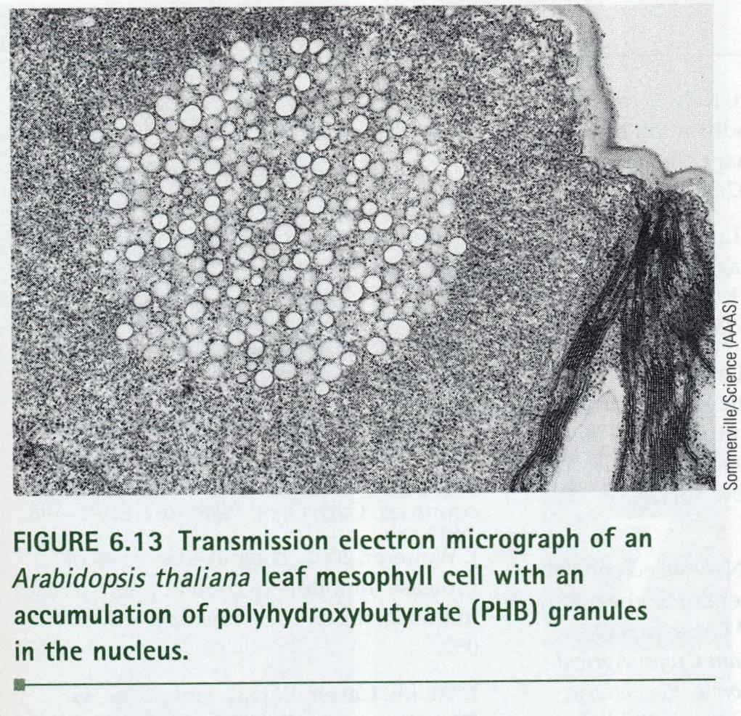

Slide 43
IV. A Bright Future.
A. Modern biotechnology should embrace safer, less toxic agricultural practices as well as the conservation and use of germplasm.
B. Plant biotechnology has many possibilities and many concerns.
C. Microarrays, DNA chips, and genome sequencing will go a long way toward changing plant biotechnology and health care.

